Slide 1
C card churners data analysis
MENU
ANALYSIS
CONTACT
Group 3 (no pun indented)
Credit

Slide 2
Hello!
MENU
ANALYSIS
CONTACT
Data ANALYSIS
A presentation brought to you by:
No Pun Indented

Slide 3
INTRODUCTION
MENU
ANALYSIS
CONTACT
Data ANALYSIS
We will be analyzing a data set of customer information from a bank that is concerned about the high churn rate. Credit Card churning is the practice of repeatedly opening and closing credit card accounts to continually receive the incentives that are given to those who open new credit card accounts. We will be performing exploratory data analysis on this dataset, to see if we can gain any insight into which customers are more likely to churn and is there anyway of decreasing that number.

Slide 4
CONTENTS
MENU
ANALYSIS
CONTACT
Data ANALYSIS
Where did we find the dataset and how did we use it to answer our questions?
What questions are we asking and why?
The clean up and EDA process
Our conclusions and their implications

Slide 5
The Data
The dataset we were working with was from Kaggle (although originally from leaps.analyttica.com) and was comprised of information of customers who were under the banks’ credit card services.
The dataset consists of over 10,000 customers and hosts a wide variety of information.
This allowed us to look at several relationships within the data to identify any possible trends, that may allow us to predict which customers are more likely to churn.

Slide 6
Key questions
MENU
ANALYSIS
CONTACT
Can we compare gender and age to the attrition status of customers, to identify any trends?
How does the familial situation affect the attrition status of customers? Can we use gender, age, marital status and dependents to identify any correlation between familial situation and attrition status?
Does how long the customer has been inactive give any indication to whether a customer may leave? Using months inactive and months on book, can we recognize what may be a trigger point for customers leaving?
Is there a relationship between education and income levels - do higher education and income correlate? Are those with a higher income and higher education level more likely to stay with the bank? Are people with a lower income more likely to leave? (Does a high number of dependents and low income have any effect?)
What is the relationship between card category and income? Are those with a higher income on a better card, and are those on better cards more likely to stay or leave?
Do customers on higher income have higher transaction levels? Is there any correlation between transaction amounts and how long customers have been inactive?

Slide 7

METHODS, TECHNIQUES AND TOOLS
MENU
ANALYSIS
CONTACT
Data ANALYSIS
Do you know what helps you make your point clear? Lists like this one:
They’re simple
You can organize your ideas clearly
You’ll never forget to buy milk!
And the most important thing: the audience won’t miss the point of your presentation

Slide 8
DATA PROCESSING
MENU
ANALYSIS
CONTACT
Data ANALYSIS
NEPTUNE
JUPITER
VENUS
It’s the farthest planet from the Sun
CERES
Venus is the second planet from the Sun
MARS
saturn
Mars is actually a very cold place
mercury

Slide 9
and Visualisation
MENU
ANALYSIS
CONTACT
Data ANALYSIS
analysis

Slide 10
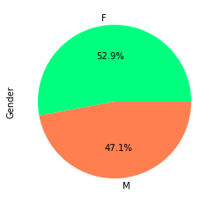
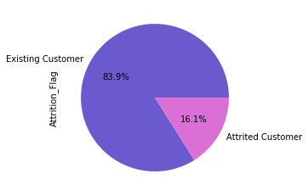
Question 1
The first question we looked at was to identify if there were any trends between customer age, gender and attrition status. We first used pie charts to allow for easy visualization. (They are nice to look at)

Slide 11
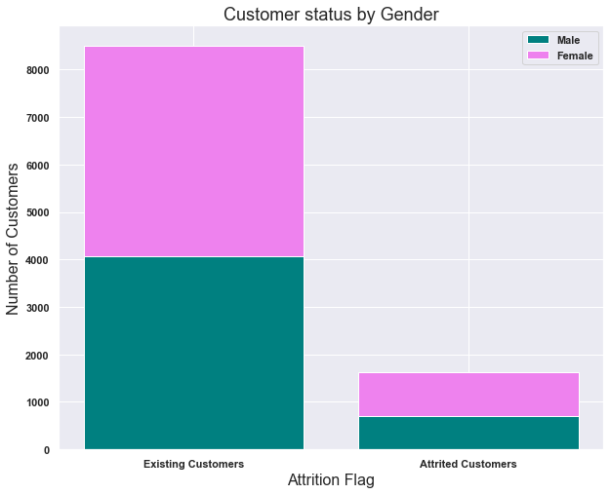
Question 1 cont.
We then created a stacked column chart to allow for comparison between the genders and the attrition status.

Slide 12
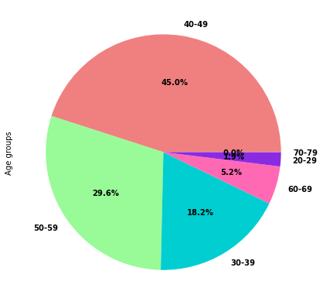
Question 1 cont. again
We then looked at the customer ages, by putting them in the bin. We first visualized the age groups with a pie chart.

Slide 13
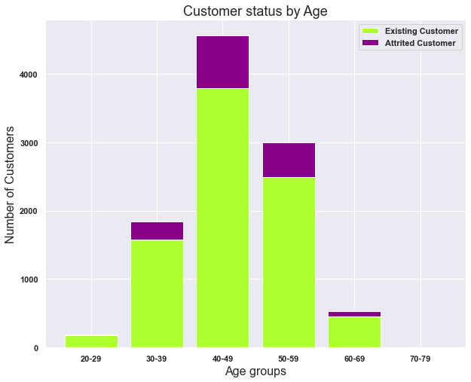
Question 1 cont. again
We then created a stacked column chart looking at the attrition status within the different age groups.

Slide 14
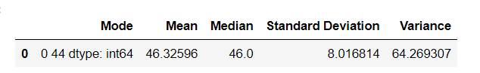
Question 1 cont. again
So, what do these visualizations tell us and what conclusions can we draw from this?

Slide 15
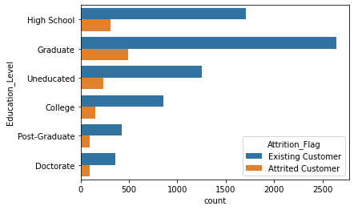
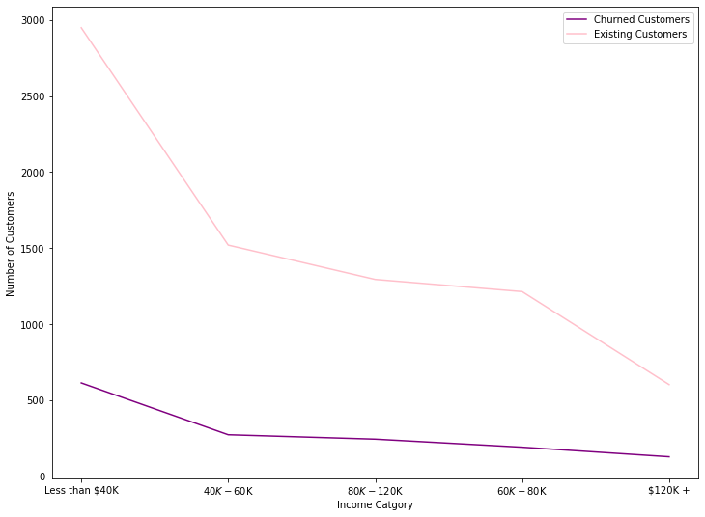
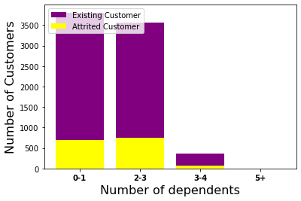
Q4:
MENU
ANALYSIS
CONTACT
Data ANALYSIS

Slide 16
THANKS!
MENU
ANALYSIS
CONTACT
Data ANALYSIS
Do you have any questions?
No pun indented
+44 1231231312
nopunindented.com
Please keep this slide for attribution

Slide 17
Any questions
MENU
ANALYSIS
CONTACT
Data ANALYSIS

